Slide 1
Float Glass Plant Opportunities
An In-Depth Analysis of Electrical Rates and Trends in the United States
Faris Alquaddoomi, Ethan Frisch, Megan Morrissey, Ajay Parthasarathy
Notes:
Your group will also submit a Powerpoint presentation (.pptx), consisting of 7 - 10 slides, in which each group member will present at least one slide. This presentation should contain information on the following: Introduction/Problem statement, Methods used (visualization and modeling methods), Results, Limitations and next steps.
Ajay - 1,2
Faris - 3-6
Ethan - 7-9
Megan - 10-12

Slide 2
Problem Statement
Glass factory float lines generate significant amounts of wasted heat, which represents an opportunity for heat reclamation. The problem lies in converting the heat to useful electricity with an economically viable waste heat recovery system. Glass factories currently source electricity from the grid at competitive rates for industrial consumption. For our solution to be cost-competitive with electricity generated from fossil fuel plants, it must supply electricity at a lower comparative price.

Slide 3
Modeling Methods
Latitude and Longitude mapping of:
Electricity prices
Float glass plants
K means clustering
3 groups cluster
4 groups cluster
Notes:
We constructed a model within a pandas dataframe that contained the location of float glass plants in the US as well as the distribution of industrial electrical prices by state
We turned these dataframes into geodataframes for the purpose of creating maps containing electricity prices and float glass plant locations
We utilized functions within the geopandas library to perform reverse geocoding - this process allowed us to map latitude and longitude coordinates to each float glass plant in the US
We then produced several maps displaying the electrical price distribution and float glass plant locations, as well as a histogram of electrical prices for float glass plants - assuming the plants pay the statewide industrial rate for electricity
We finally performed a K-means clustering analysis on the float glass plant locations. We used the elbow method to determine the optimal number of clusters, which turned out to be 3. We also tested 4 group clusters and created overplotted maps to display the results.

Slide 4
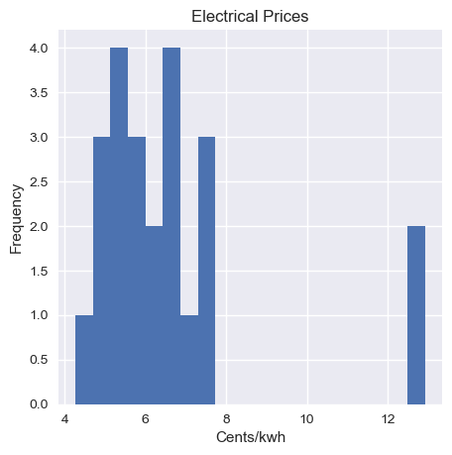
Visualizations
Notes:
This histogram displays the price float glass plants pay for electricity. The histogram is limited to US-based float glass plants and assumes glass plants pay the statewide industrial rate for electricity.
We can see a clear grouping of electrical prices around the 4.5 to 7 cent per kilowatt-hour range, with 2 outliers in the >12 cent per kilowatt-hour range.
This histogram supports the notion that float glass plants are generally located in areas with cheaper electricity prices.

Slide 5
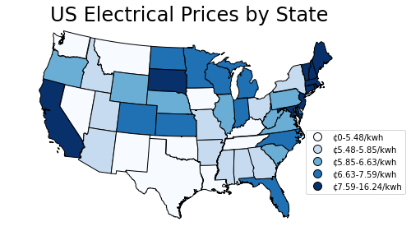
Visualizations
Notes:
Th

Slide 6
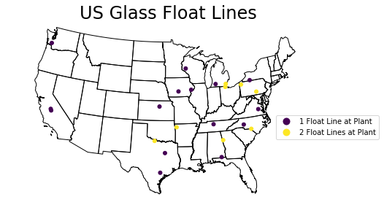
Visualizations

Slide 7
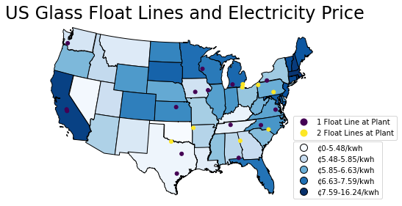
Visualizations
Notes:
Change legend to cents
By comparing electricity with US glass float lines, we can see that most glass float lines are in areas where electricity is cheaper. They are mainly in the midwest and the the east coast, with a couple along the western united states. Typically where the electricity is cheaper, that is where you can find a lot glass manufacturing plants which happens to be in the midwest

Slide 8
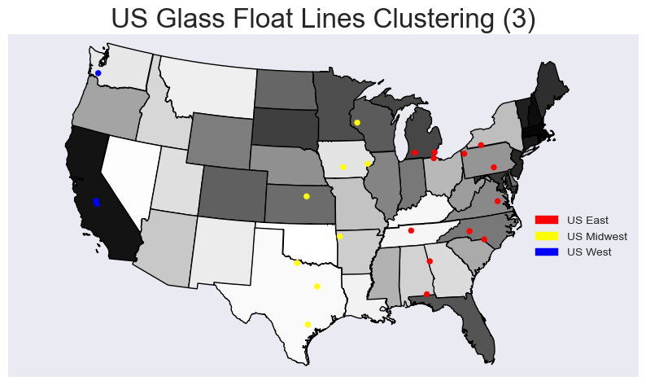
Visualizations
Notes:
Add legend with clusters: West, Midwest, East US
Used elbow method, method used for determining the optimal number of clusters, which is 3
Passed 3 cluster to a k-means algorithm and made these groups which we are calling west, midwest, east United States

Slide 9
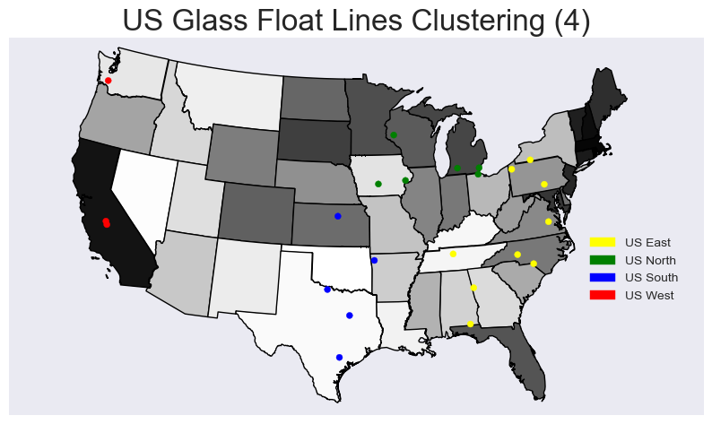
Visualizations
Notes:
Add legend with clusters: West, North Midwest, South Midwest, East US
We cross validated by using 4 clusters to the K-means algorithm
East and West remained fairly unchanged
The Midwest separated into two distinct clusters (one in the north and one in the south)
We prefer the results from the 3 cluster better as it represents the accurate number of clusters

Slide 10
Results
Glass plant locations comprise 3 clusters: Western US, Midwest US, and Eastern US clusters.
West and Midwest clusters are distributed within areas of predominantly lower electricity price
We would charge an average of 6 cents per kilowatt-hour to remain competitive with on-grid electricity rates

Slide 11
Limitations
Electricity price changes
States don’t report correct electricity prices
Glass plants pay a different price for electricity than reported statewide
Number of glass float lines in the United States

Slide 12
Next Steps
Carbon Emissions and Carbon Credit Pricing
Taken from the World Bank Carbon Pricing Dashboard
Using the 64 Initiatives that are currently existence
Linear Regression Analysis
Quantify the total revenue we can expect from each glass float plant location and display on interactive web map
Logistic regressions on carbon prices, using historical prices from Europe as training sets for our model.
Forecasting carbon credits and carbon prices as they get introduced to markets
As supply for carbon credits go down, demand goes up

